Slide 1

Sales 2019 Data Visualization (Tableau)

Slide 2
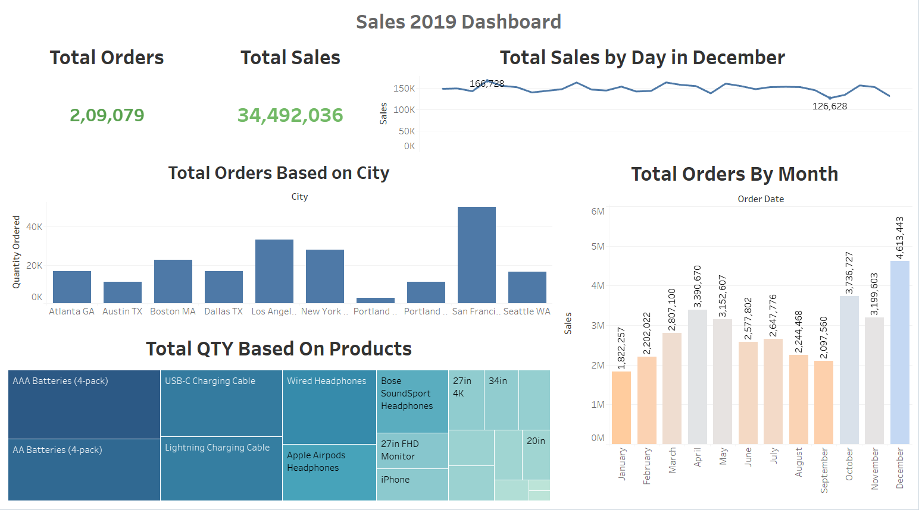
Sales 2019 Dashboard
Total Sales for year 2019 was 34,492,036.
The major sale month was December.
Sales in December can be high as it is the holiday month and people buy gifts and many things.
The most buyers were from San Francisco overall this year.

Slide 3
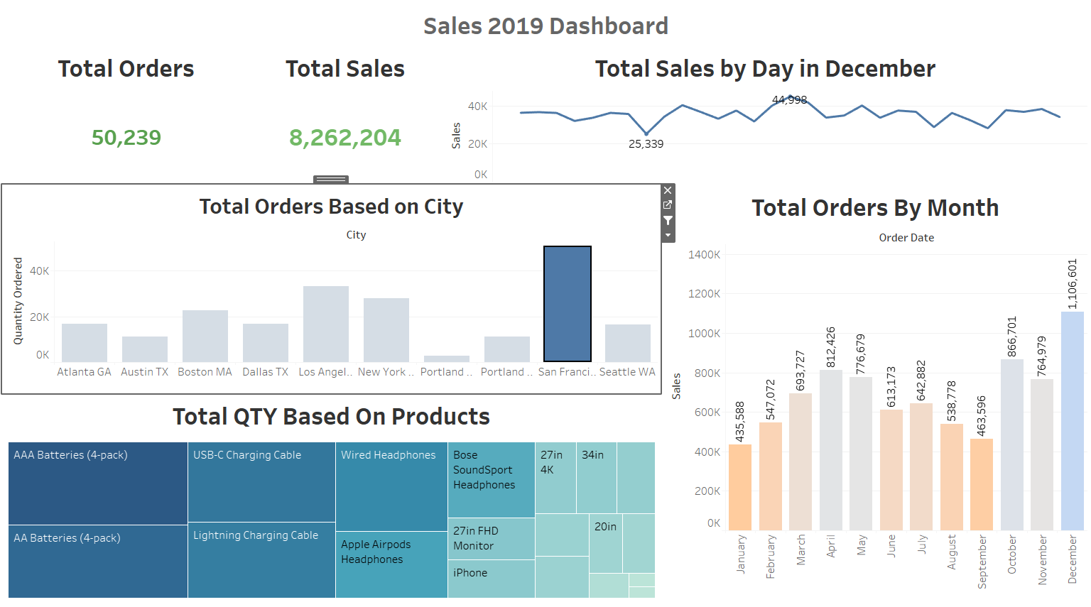
Total Sales in San Francisco
The result for sales in San Francisco can be seen by filtering the dashboard.
Total orders here were 50,239, which is a major part in orders.

Slide 4
Total Sales in San Francisco
In the month of December, the lowest day sale was 25,339 and highest day sale was of 44,998.
The highest selling product this month was AAA Batteries.
The lowest selling month was January where the orders placed were 435,588.

Slide 5
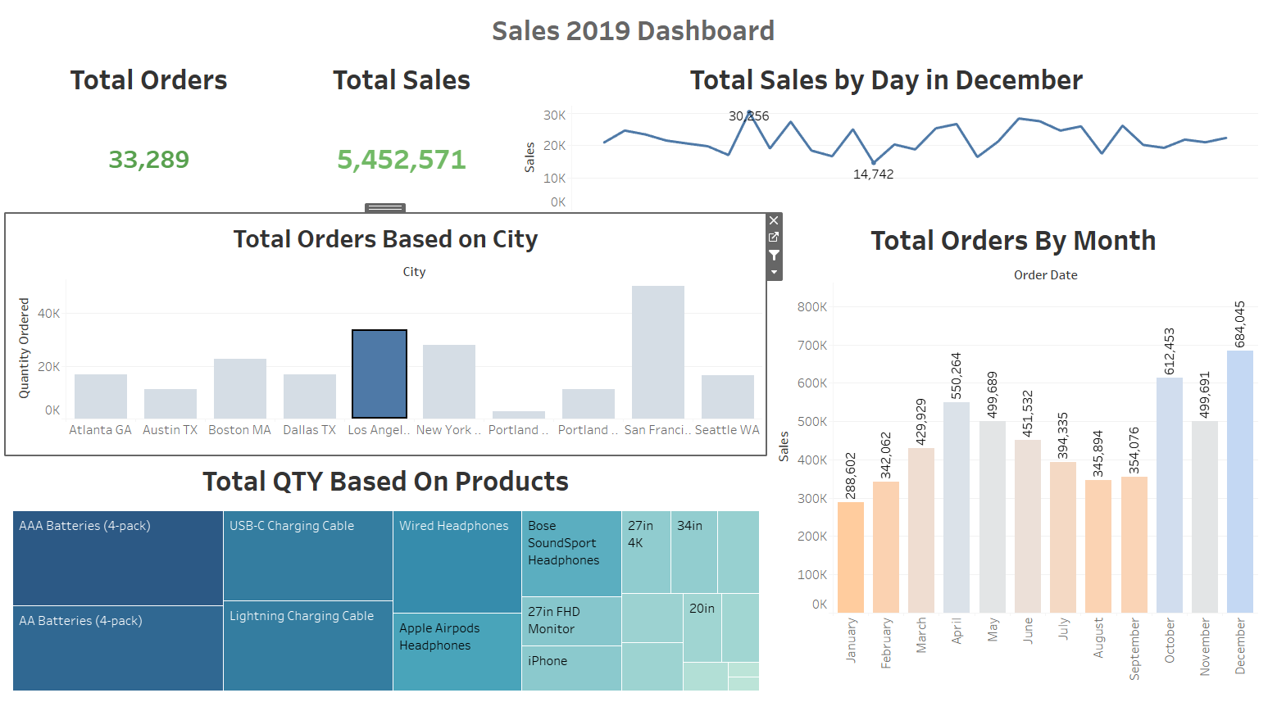
Total Sales in Los Angeles
Total orders placed were 33,289 in Los Angeles.
Los Angeles was the second most profitable city after San Francisco.
The highest selling month in Los Angeles was also December.

Slide 6
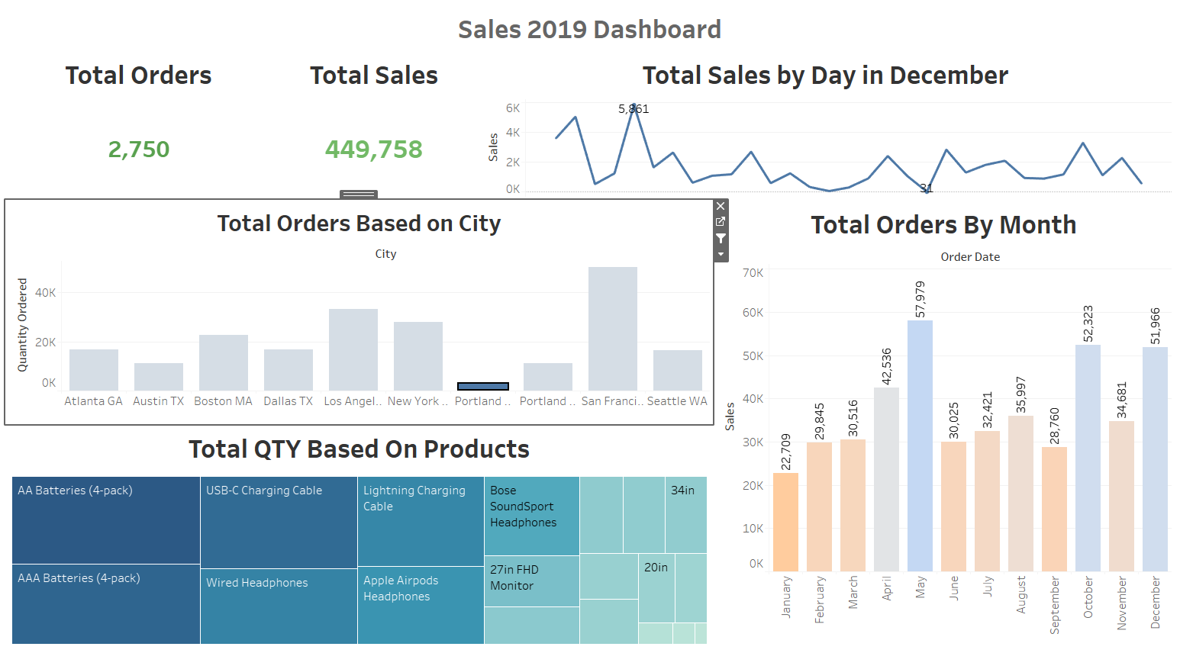
Total Sales in Portland(ME)
Portland(ME) had the least sales among all the cities overall year.
Total order placed here were 2,750.
The most ordered product here was AA Batteries.

Slide 7
Total Sales in Portland(ME)
In Portland(ME), May was the most selling month with 57,979 orders.
By this, we can say that more marketing can be done in Portland(ME) to get more customers.
While San Francisco is richest city among these, we can target more customers over here too and can attract more customers.

